Slide 1
TEAM aMBiQuiCy
Team Members:
Andrey
Anne
Cristopher
Georg
Marc
Shraddha
Yao
Project: MBQC subroutine for SimulaQron
Implementation: Blind Quantum Computation

Slide 2
WORK FLOW:
INPUT
MBQC Transformation
Flow Construction
MBQC Code on SimulaQron
Blind Quantum Computation Code

Slide 3
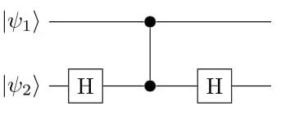
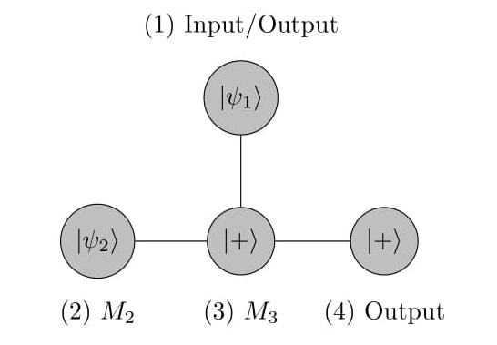
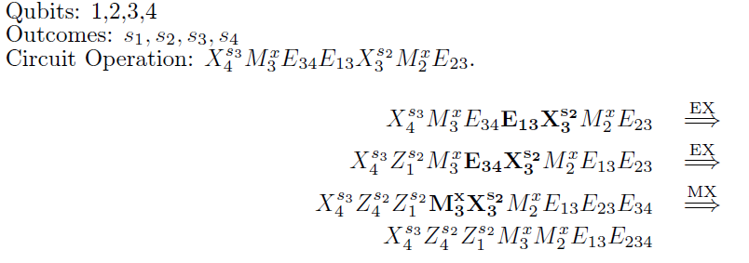
MBQC transformation:
(Includes only measurement and entanglement)
Example: C-NOT
INPUT: H₂E₁₂H₂
SimulaQron
3.) Flow Construction

Slide 4
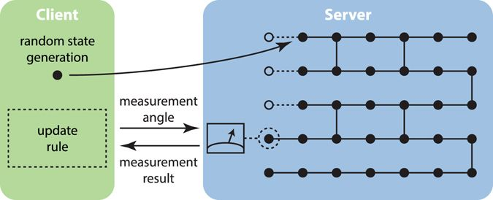
1.) Client generates random Qubits
2.) Client sends qubits to Server and entanglement information
3.)Server entangles the received qubits accordingly
4.) Client computes measurement angles for qubits using update rule and sends it to the Server
5.) Server measures and communicates the measurement result to the Client
6.) Client uses the received result to recover correct outcome of computation.
BLIND QUANTUM COMPUTATION

Slide 5
DEMO
https://giant.gfycat.com/EarnestImperturbableAbalone.webm
EXTENSION
Current Blind Quantum Computation protocol incorporates only classical input/output case but MBQC subroutine is designed for quantum and classical input/output . Protocol can be extended to the quantum input/output case by adding following steps
quantum one time pad of input/ output states during generation of qubits
output correction of output qubits in the end.
Use universal resource states for MBQC for better security

Slide 6
Thanks!

